Slide 1
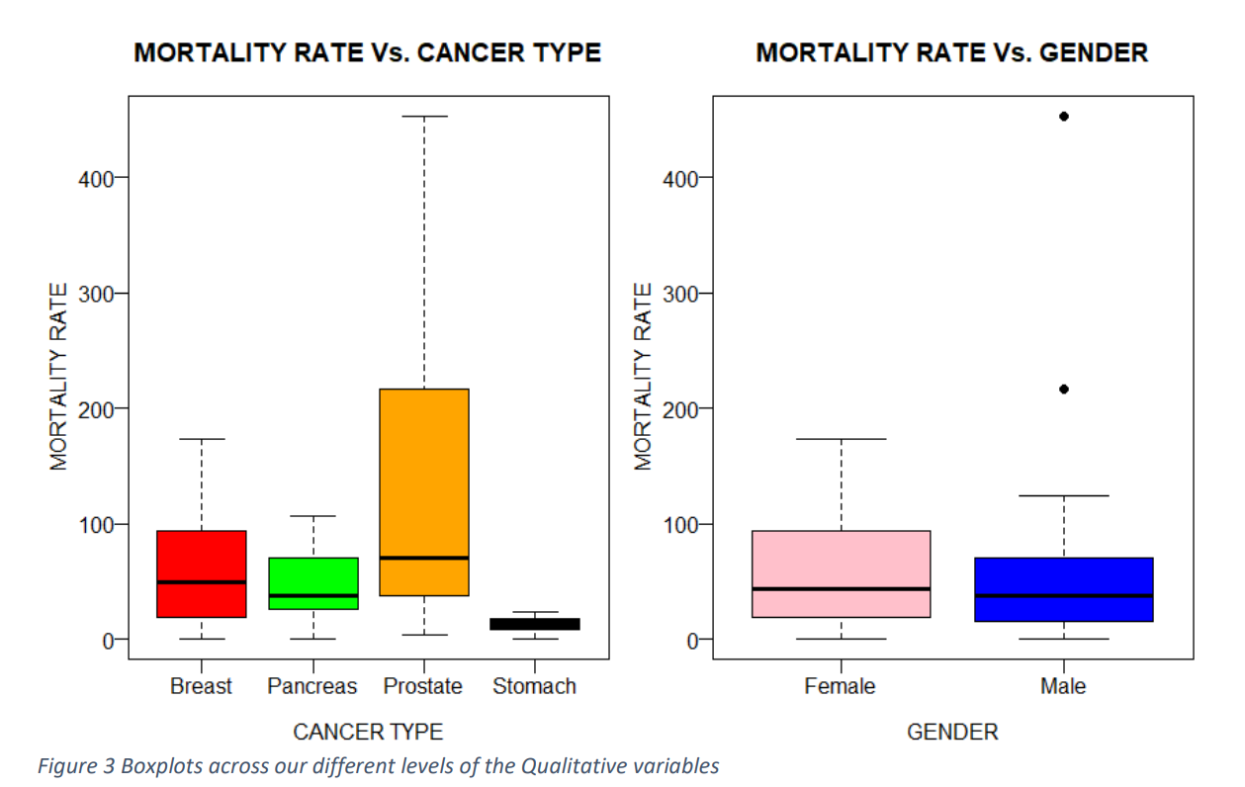
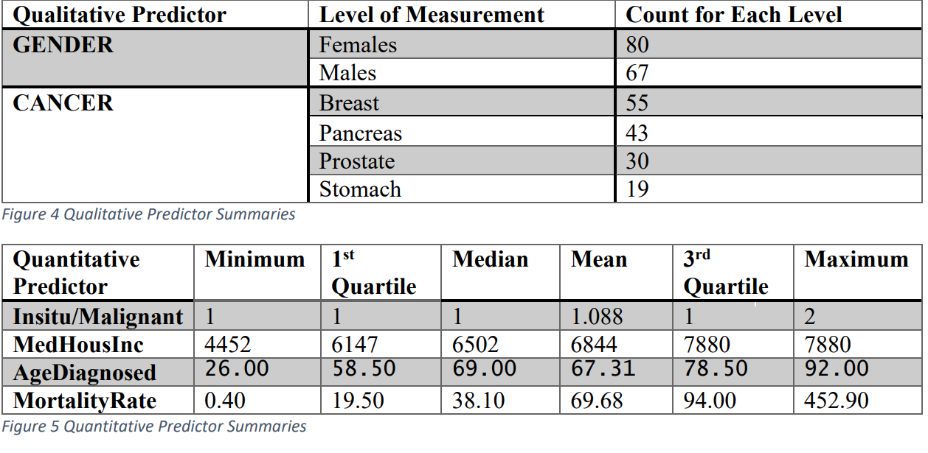
Predicting Mortality Rate associated with type of Cancer, and other variables.
Tenki Ko and Steve Mwangli
Introduction
Results
The important background for this study includes:
The probability
Simple linear regression
estimate the coefficients
Our objectives are:
1.Assess the relationship between mortality rate and the type of cancer.
2.Determine whether this relationship is affected by a person’s age and gender.
3.Calculate whether there is any correlation between the household income in a county and the mortality rate of patients suffering from different types of cancer.
4. Gauge how much the total number of in situ tumors and malignant tumors affect the mortality of cancer patients.
Sentence or two, or bullets, giving main results, or descriptive title.
Results Figure or Table with title and caption
There is greater variability in the mortality rate of female cancer patients compared to male cancer patients, even though there are two outliers in the upper portion of the male boxplot. Additionally, the female boxplot corresponds to the boxplot of patients who suffer from Breast Cancer, which could be
attributable to the fact that most people who suffer from Breast Cancer are female.
Methods
All analyses were conducted using the R Statistical Program
(R Core Team 2018)
1. Obtain data
National Cancer Institute
2020
2. Exploratory Data Analysis
Cancer Type
AgeDiagnosed
MedHouInc
Gender
INSvsMALI
Results Figure or Table with title and caption
Numerical summaries of each of the variables
3. Model Estimation
Rstudio
4. Model Assessment
boxplot
scatterplot
No
5. Final Model
Yes
Model Adequate?
Conclusions
References
Sentence giving main conclusion. Reference tables or figures as appropriate
There is definitely a correlation between some of the predictor variables and the mortality rate
Type of cancer could also be used in a further study to investigate whether it could be used as an explanatory variable
There might be a need to implement the in situ or malignant tumors as factors, or dummy variables, or qualitative variables.
For further study:
Type of cancer for qualitative variable
Melanoma and other skin cancer types as a predictor
Colorectal or testicular cancer as predictors
Monica, K. (2018, July 30). EHR Data Helps to Predict Short-Term Mortality for Cancer Patients. Retrieved from ehrintelligence.com: https://ehrintelligence.com/news/ehr-data-helps-to-predict-short-term-mortality-for-cancer-patients
Ni, D., Xiao, Z., Zhong, B., & Feng, X. (2018, November 9). Multiple Human-Behaviour Indicators for Predicting Lung Cancer Mortality with Support Vector Machine. Scientific Reports. doi:https://doi.org/10.1038/s41598-018-34945-z
Parikh, R. B., Manz, C., Chivers, C., Regli, S. H., Braun, J., Draugelis, M. E., . . . Patel, M. S. (2019, October 2). Machine Learning Approaches to Predict 6-Month Mortality Among Patients With Cancer. JAMA Netw Open.

